Slide 1
Spark Framework

Slide 2
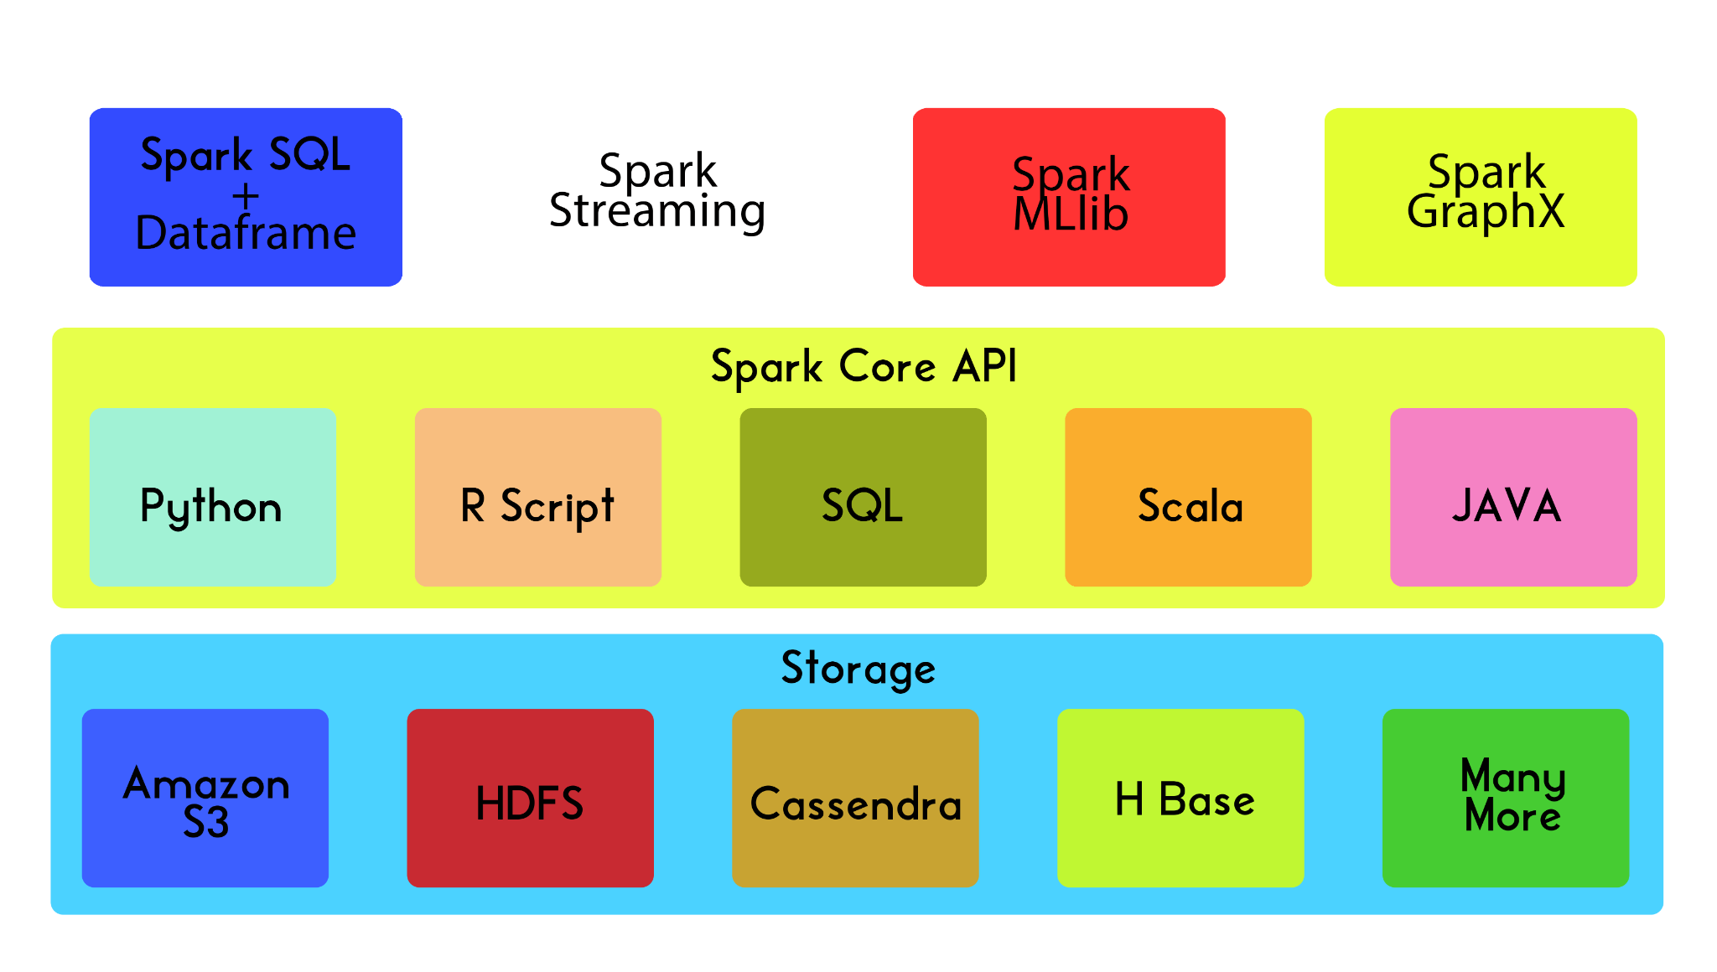
Spark Framework

Slide 3
Spark SQL
Allows to run SQL queries on distributed dataset.
All data preprocessing can be accomplished using it.
Nowadays, no one writes Spark core code.
Internally converted into spark core code and gets executed.

Slide 4
Spark MLlib
Provides access to machine learning algorithms.
Contains majority of machine learning algorithms
Classification algorithms
Regression algorithms
Clustering algorithms
Recommendation engines and so on

Slide 5
Spark Streaming
Widely used in the field of data analytics.
Ingests data in mini-batches and then applies RDD transformations.
According to IBM
60 % of all sensory information loses its value in milliseconds if not acted on.

Slide 6
Streaming data analysis
People used to post tweets on Twitter.
Stream of tweets for every second
As a organization
Twitter wants to analyze
What are the trending hashtags?
Must perform very fast analytics.
Spark streaming will come in handy.

Slide 7
Spark GraphX
Mostly used for graph processing or graph parallel computing.
Helpful to do social network analysis.
For example,
Data from any social media.
Can build a network recommendation
Who should follow whom?

Slide 8
Polyglot spark
Spark is written in a programming language known as Scala.
As time passed, the designers of Spark added support.
JAVA
Python
R Script
In this course
Spark SQL and Spark MLlib and Spark Streaming using python

Slide 9
Recap
IN THIS LESSON
spark frameworks
languages support in spark
IN NEXT LESSON
Why should we use PySpark?

